Slide 1

B. Tech ECE FINAL YEAR PROJECT -FINAL REVIEW
Real-Time Air Quality Monitoring and its predictions
Using IOT to send data gathered by the hardware configuration to an intuitive website and using prediction algorithms to determine if area is safe

Slide 2

TEAM
Rutwik Mekala(17BEC0039)
Akhil Reddy Nagulapally(17BEC0648)
A.V.S.S Rohith(17BEC0483)
Faculty
Sangeetha S, SENSE

Slide 3
Literature Survey
S.NO | NAME OF THE PAPER | AUTHORS | METHODS USED | PARAMETERS USED | CONCLUSION | YEAR
1 | Weather forecasting using deep learning techniques | Salman, Afan Galih, Bayu Kanigoro, and Yaya Heryadi | ANN and fuzzy logic wavelet model, NN, wavelet NN, and Support Vector Regression (SVR), Rainfall forecasting model based on an ensemble of artificial NN | k-fold Crossvalidation, ENSO variables, gradient descent | High prediction Accuracy, Big data handling, optimal solution | 2015
2 | Smart Air Quality Monitoring System with LoRaWAN. | Thu, M. Y., Htun, W., Aung, Y. L., Shwe, P. E. E., & Tun, N. M. | LoRaWAN gateway, Python programming and ARIMA model to make predictions. ARIMA is an abbreviation for Auto-Regressive Integrated Moving-Average. It has been used for time series forecasting. | Amounts of dust, CO2 in ppm, temperature in degree celsius and humidity | The outcome is a scalable system to monitor the amounts of dust CO2, temperature and humidity that are essential factors in air quality monitoring. This system uses LoRa network that has high potential in the future because many cities around the world are planning to have the LoRa coverage serving as a necessary communication backbonet | 2018
3 | Air Quality Prediction: Big Data and Machine Learning Approaches | Kang, Ganganjot Kaur, Jerry Zeyu Gao, Sen Chiao, Shengqiang Lu, and Gang Xie | Applicability of ANN, GA, SVM, Random Forest models on big data based on air quality factors | Air Pollution and Quality Index (AQI) | Analysis between different prediction model, Increased accuracy | 2018
4 | IoT Based LPG Gas Leakage Detector | Prof. Pranay Meshram, Nancy Shukla, Stuti Mendhekar, Renuka Gadge ,Shivani Kanaskar | Wireless Sensor Network and MQ Series Hazardous Gas Sensors | Propane, Butane and LPG, Natural gas | SMS Sent to user if hazardous gases found | 2019
5 | Machine Learning Capable, IoT Air Pollution Monitoring System with Upgradable Sensor Array | C.S. Elvitigala, and B.H. Sudantha | The microcontroller with module connection slots , The wireless communication device through WiFi module , The data classifying and storing server ,The machine learning and graphing software | Air Quality Index(AQI),CO concentration in ppm | Low cost Solution to monitor environment pollution,flexible and many parameters can be added or removed.The state of art machine algorithm is used to predict the air pollution and this helps an organization or government to do better planning of cities or places | 2017
6 | IoT based Air Quality Monitoring | F N Setiawan* and I Kustiawan | Integration of 3 sensors that detect different kinds of gases and particles with Nodemcu before the data detected is sent to the internet The 3 sensors are MQ2, MQ9 sensor for carbon monoxide and zh03a particle sensor for PM1.0, PM2.5 and PM10 (dust) | MQ2 sensor module is used for gas leakage detection. MQ9 sensor is sensitive and have fast response time. ZH03A module is a common type,it is a small size sensor that uses laser scattering principle to detect the dust particles in air, with good selectivity and stability | air quality detector is very important because nowadays air pollution is easy to find. For the air pollution which cannot be easy detected by human, it requires a device as a reader of the air quality. By this research, we can avoid air pollution through monitoring the air quality regularly | 2018

Slide 4
MOTIVATION AND OBJECTIVE
Air pollution is one of the biggest threats for the environment and affects everyone. The situation these days are so bad that in few cities like Tokyo and Delhi, people are gasping for breath. It is estimated that 7 million people die every year due to pollution. So the air in most of these areas can be termed as invisible poison. In such cases the least a person living in the area should be able to do is know how the quality of air is in their locality. If they see and understand the immediacy of the problem, they can find ways to save themselves. Here is where our project comes to play.
The core objective of this project is to make a device and a website such that people can have access to the information as to how bad the condition of Air is in their locality. Real-Time values are to be displayed on the website and we also explore prediction algorithms in machine and deep learning to know if the area can be termed safe or not based on the future Pollution values. We will be using IOT to send the data gathered from the sensors to the cloud server and the users can check out additional data on the website such as temperature and humidity.

Slide 5


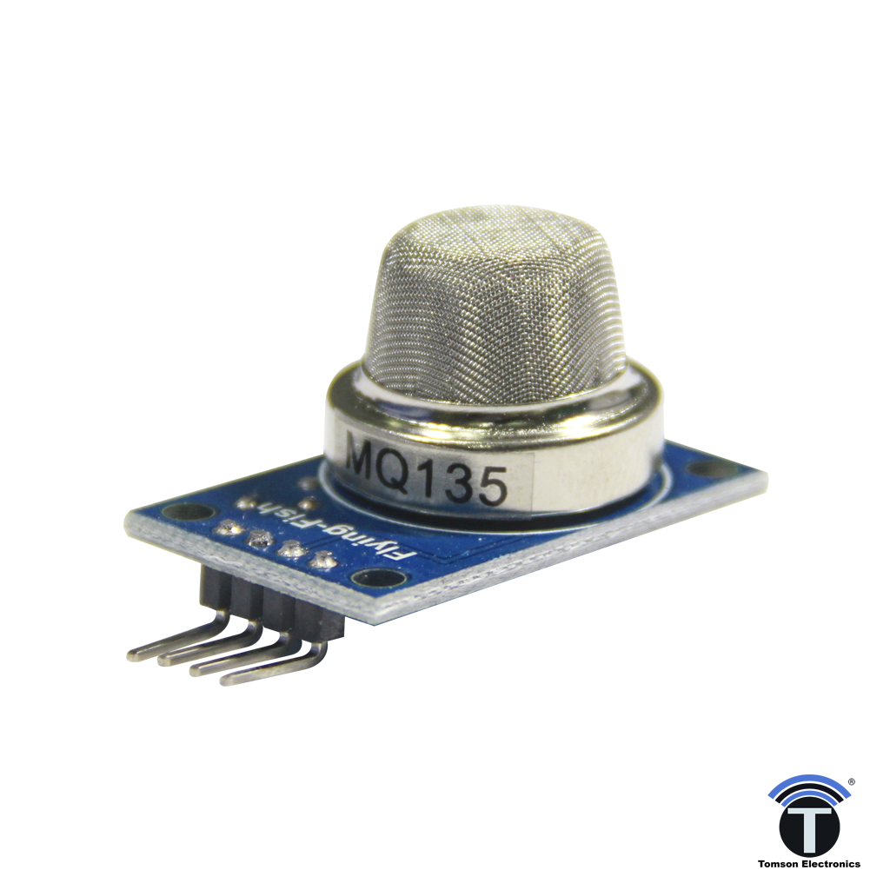
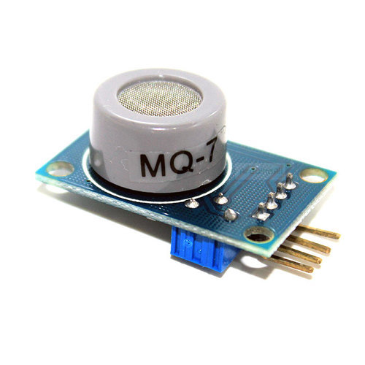
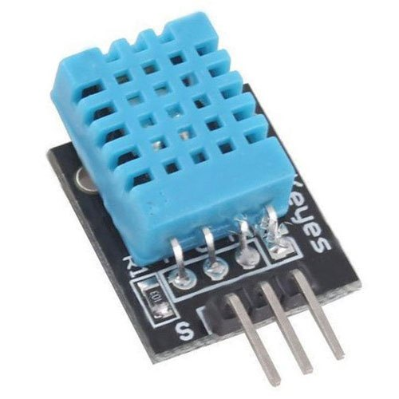

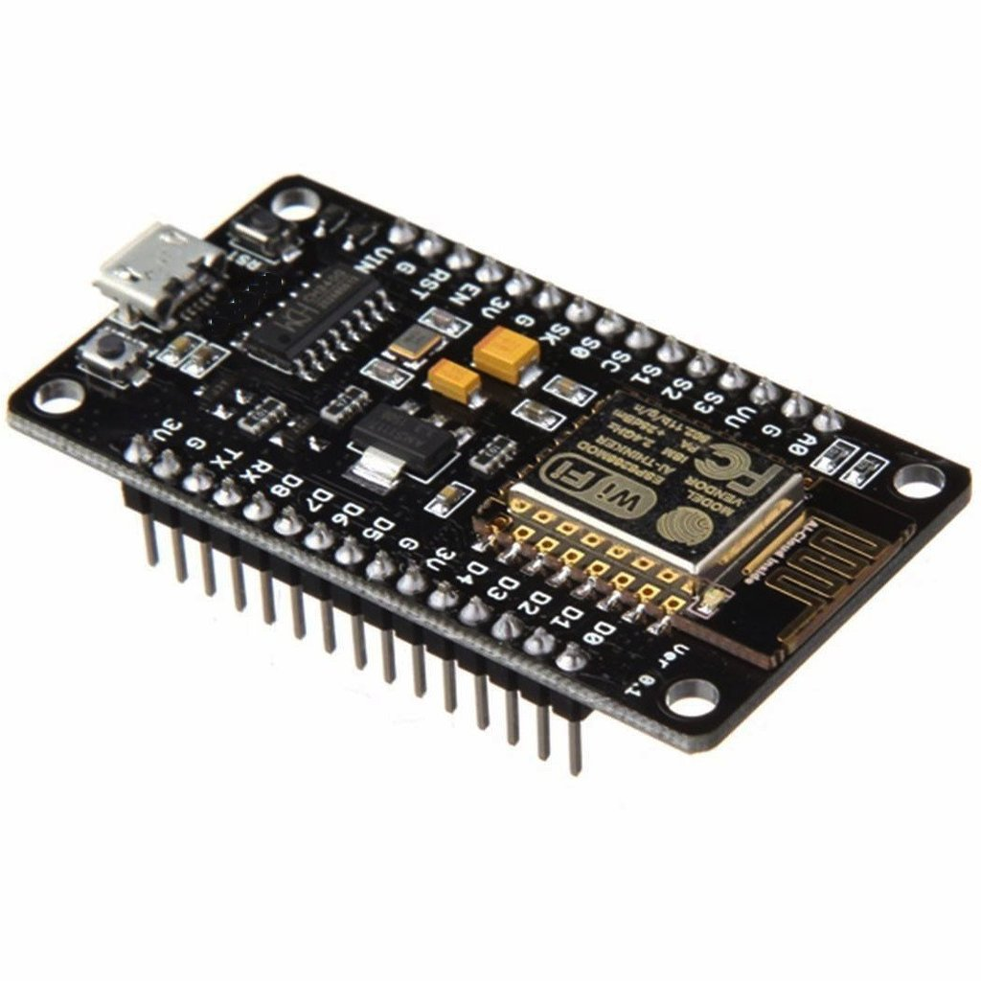
HARDWARE/SOFTWARE DETAILS
Hardware: | Software:
NodeMCU(ESP8266) MQ135 MQ7 DHT11 4051 Multiplexer Bread Board Jumper Wires | Arduino IDE Thinger.io Visual Studio Code Jupyter Notebook(anaconda)

Slide 6
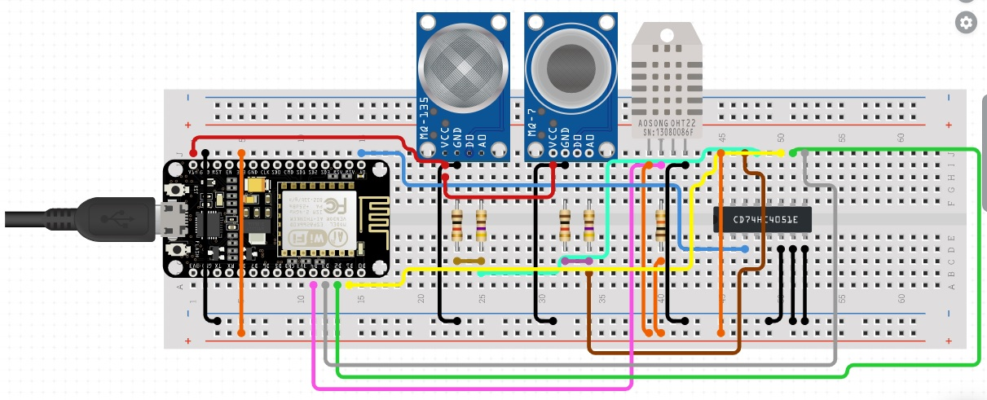
CIRCUIT DIAGRAM
FIGURE-1

Slide 7
METHODOLOGY(hardware aspect)
Referring to Figure-1,
Here we supply power to Vcc ports in all the sensors through NodeMCU and connect GND in the same way. We connect digital pins of DHT11 to digital ports of NodeMCU.
As we have two Analog sensors and one analog port in NodeMCU, we use 4051 mux to compensate for lack of analog ports and connect MQ135 and MQ7 sensor to NodeMCU through 4051 mux. To calibrate the sensors for accuracy, we used suitable libraries.

Slide 8
METHODOLOGY(IOT aspect)
We use Arduino IDE to upload a suitable code into the NodeMCU and we configure it with an IOT platform i.e. thinger.io.
Here we send a command to NodeMCU to upload the data received from the sensors into thinger.io in Real-Time with a delay of 2 seconds
To store the data we are receiving on thinger.io, we use a feature called Data buckets so the information can we stored continuously into an excel sheet.

Slide 9
METHODOLOGY(Prediction aspect)
Using Data Buckets, we were able to store over 10000 readings of humidity, temperature, MQ135 ppm values and MQ7 ppm values collected in the span of two weeks.
With the data gathered, one important feature we wanted to explore is analyzation of data and checking if we can predict the future result if an area is safe or not, based on Real-Time data supplied.
For this we worked on Machine Learning algorithms such as Linear Regression, Random Forest Regressor, Logarithmic Regression, confusion matrix
and Deep Learning algorithms like Artificial Neural networks to achieve it. We have found that deep learning ended up giving more accurate and elaborate results compared to machine learning

Slide 10
METHODOLOGY(End-user experience aspect)
Now that we have set-up and are able to gather data from the sensors and output of prediction algorithms, we needed a canvas where people can access the data.
For this purpose, we created a website using html and css.
In the website, we provided information about Pollution, why we need to take it seriously and few solutions to reduce Air Pollution provided by WHO.
There is a clickable link, which when clicked redirects you to all the sensor data being shown in Real-Time.
We also provided clickable links for Machine and Deep learning on the website which redirects you to the code where you can give current data as input to find out if an area is safe or not

Slide 11
PROBLEMS FACED AND HOW WE FIXED THEM
Challenges with Accuracy
An issue we faced was NodeMCU was unable to sit well with the breadboard. As a solution we used male-to-female jumper wires and connected it to the breadboard. This gave rise to another problem. We were unable to use resistors to regulate voltage levels so the sensors showed unregulated values. So we decided this can only be fixed through the software route. So we did extensive library search and found and modified suitable libraries which now shows accurate results.
Means to display results
We were initially planning to make an app to display results but few of the teammates were unable to use it as they had an iphone and app was made using android studio. So we switched over and decided to stick with website as it can be accessible from all platforms.

Slide 12
PROBLEMS FACED AND HOW WE FIXED THEM
Reason to choose thinger.io
As for using IOT platflorm, there are multiple choices to choose from. We initially worked on thingspeak.com. It had very basic functionality but the major drawback is its data-receive rate in 15 sec which might be too long. So we moved to thinger.io which has an additional feature called data buckets which can help up store information gathered effectively. And it can receive data in 2 sec time which is very efficient
Issue with lack of analog ports in NodeMCU
One major disadvantage of NodeMCU is it has a single analog port. To fix this issue, people have used Arduino uno as an extension for more analog ports but it tremendously increases the costs. So to maintain low price, we went with 4051 mux with which we were able to get multiple analog sensors connected to NodeMCU

Slide 13
COST ANALYSIS
We have extensively tried to cut our costs for this project. In most of the other research papers, they generally use Arduino Uno as it has capability of multiple analog ports which NodeMCU lacks.
Now that we solved the problem with 4051 mux we use NodeMCU which costs considerably less than Arduino Uno which will again need an external Wi-Fi module to perform IOT functions adding to the cost. The cost analysis for Arduino based model is
Arduino uno –>620 rs + ESP8266 WiFi module->250rs + jumper wires – >10rs+3 sensors- >500rs + Bread board ->65 = 1445rs
Whereas our setup costs the following
EQUIPMENT | COST( rupees)
NodeMCU | 350
Jumper Wires | 10
4051 mux | 20
MQ135+MQ7+DHT11 sensors | 500
Bread Board | 65
 | 945

Slide 14
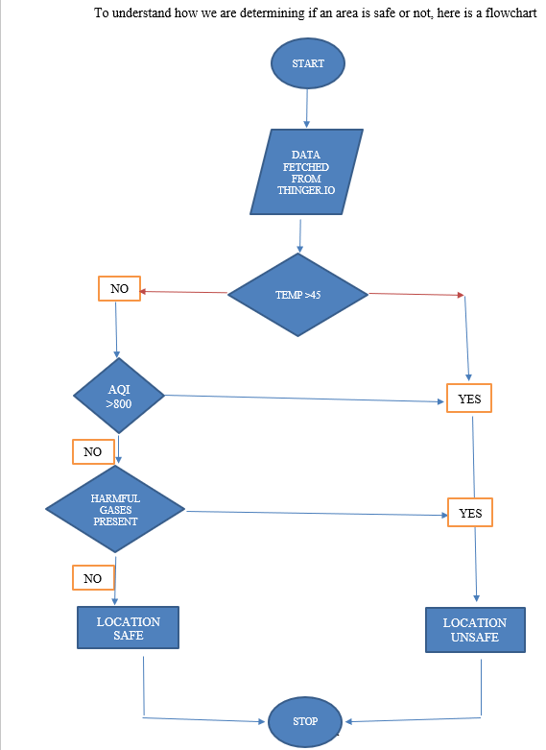
FLOWCHART
AQI range in ppm
0 ppm – 600 ppm: Good for health
600 ppm – 1200 ppm: Moderate
1200 ppm (and above): Harmful to health

Slide 15
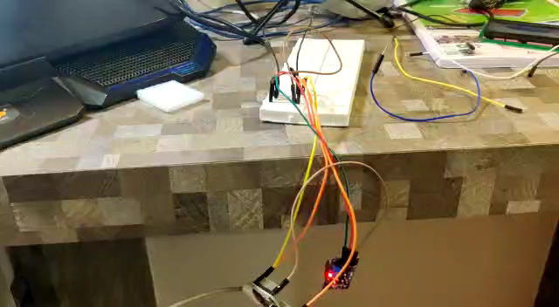
RESULTS(functioning of sensors)

Slide 16
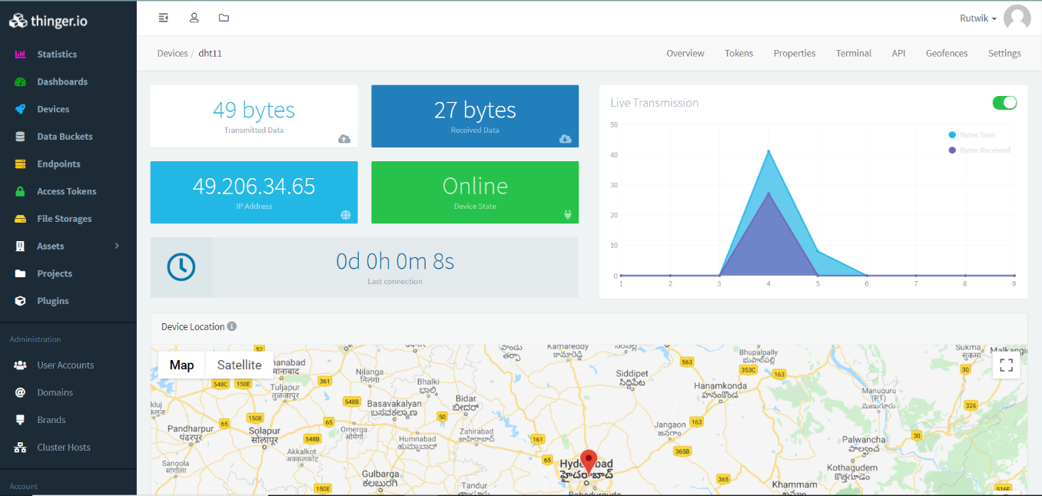
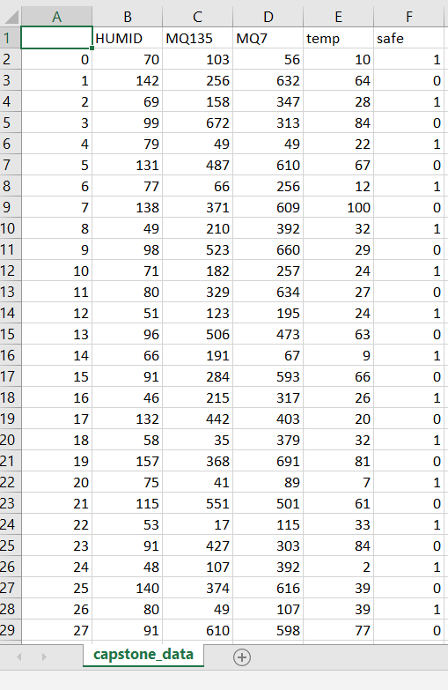
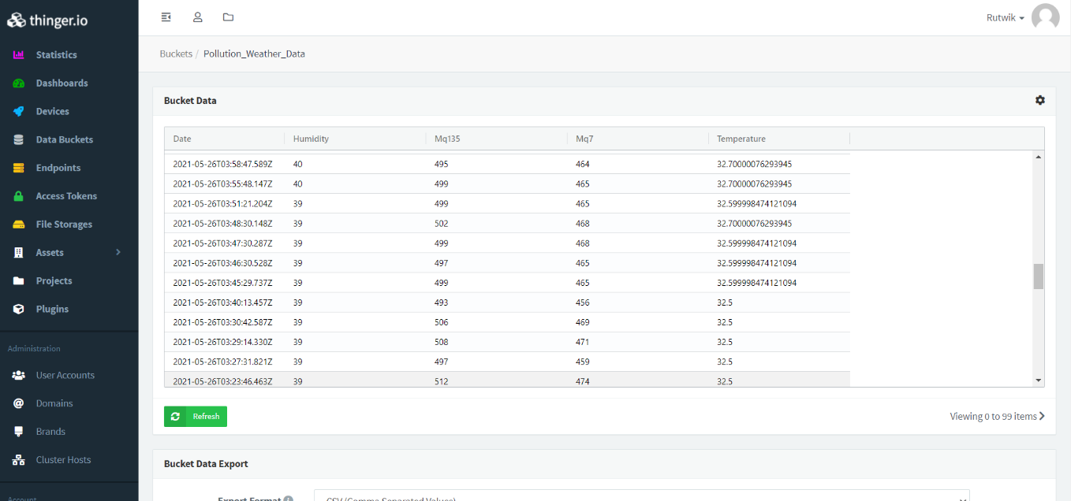
RESULTS(IOT data receiving and storing)

Slide 17
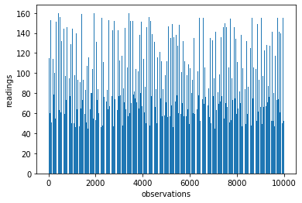
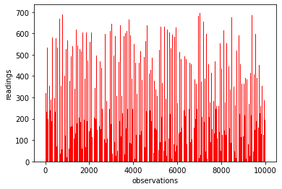
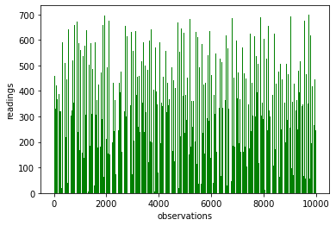
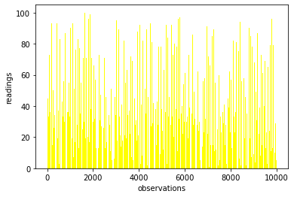
RESULTS(graphical analysis of sensor data)
Figure 2: Recorded values of Humidity. 10000 readings are taken.
Figure 3: Recorded values of MQ135 sensor. These values comprise of detection of harmful gases like NH3, NOx, alcohol, benzene, smoke, CO2. 10000 readings are taken
Figure 4: Recorded values of MQ7 sensor. These values comprise of detection of harmful gas emitted by all of fuel-vehicles i.e Carbon monoxide. 10000 readings are taken
Figure 5: Recorded values of Temperature. 10000 readings are taken
Figure-2
Figure-3
Figure-4
Figure-5

Slide 18
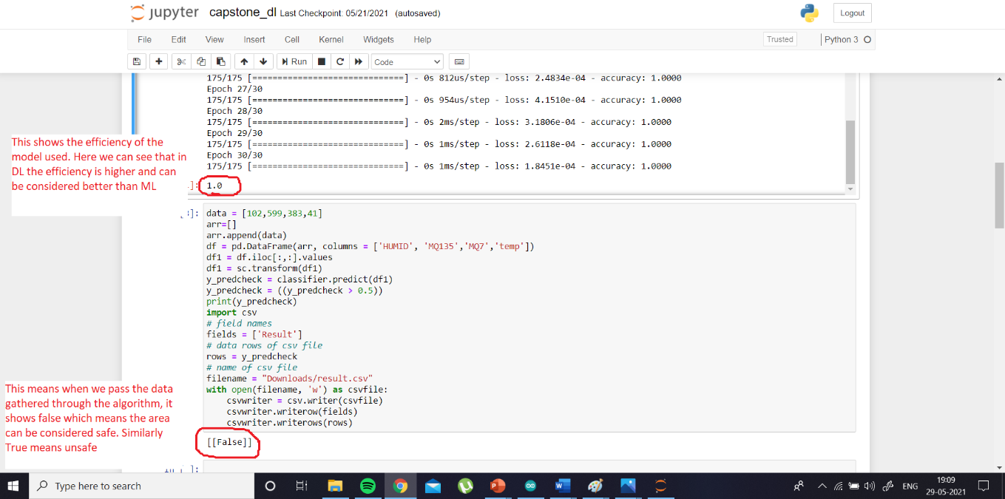
RESULTS(Prediction Algorithm)

Slide 19


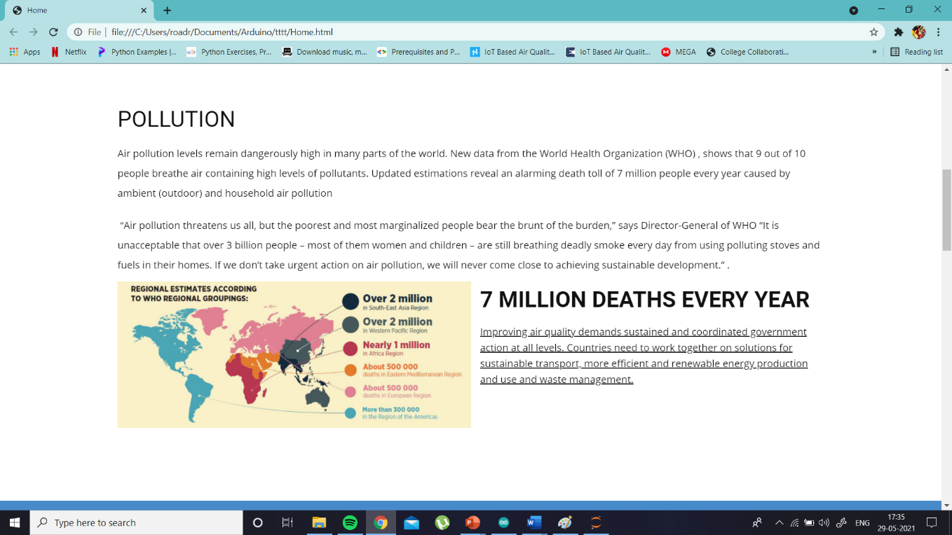
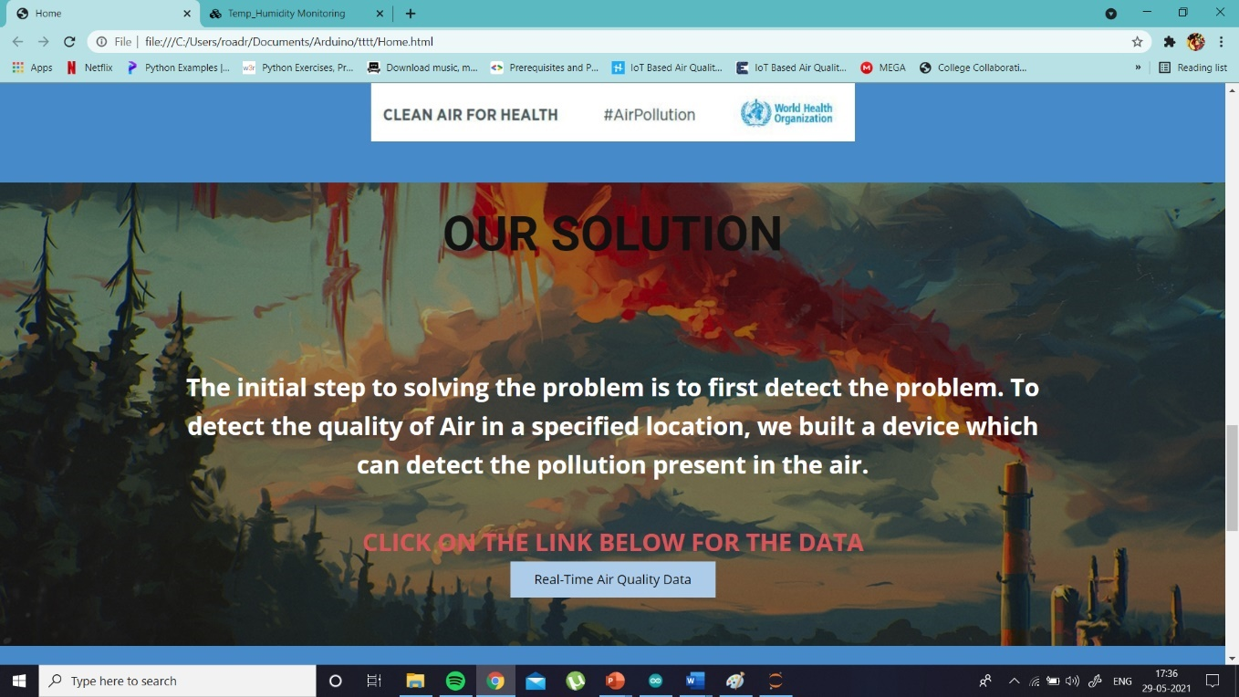
RESULTS(Website)

Slide 20
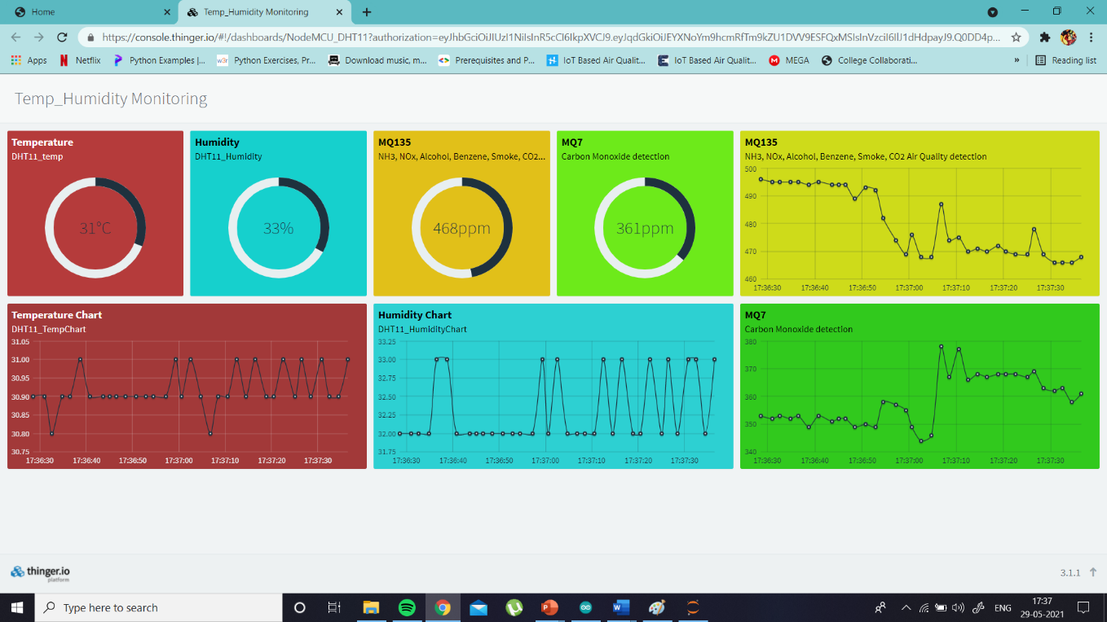
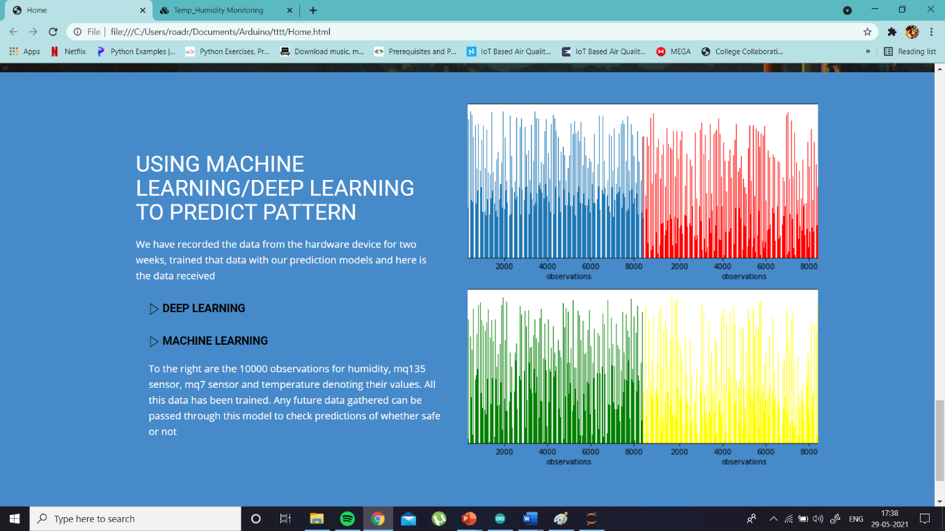
When clicked on the link, Real-Time data is shown
RESULTS(Website)
Last page. ML/DL clickable links which directs you to jupyter

Slide 21
TIMELINE
TIME DURATION | ACTIVITIES
FEB 6 | Finalized topic
FEB 7 – FEB 10 | Initiation and Literature Survey
FEB 11- FEB 25 | Finished prep-work on the approach and implementation
MAR 1- MAR 15 | Received components. Worked on hardware and Arduino code testing out all possible libraries for accurate results
MAR 20- MAR 30 | Worked on sending data to IOT platform. Tested out multiple platforms to get better efficiency
APR 1- APR 15 | Debugging. Replaced few components
APR16 – APR 25 | Using data bucket to store data gathered for two weeks
APR 26- MAY 10 | Working on a machine learning and deep learning algorithm and passing the data gathered through the algorithm
MAY 11- MAY 20 | Worked on app to display results but pivoted into making a website
MAY 21- MAY 25 | Working on report

Slide 22
CONCLUSION
We have accomplished our goal of displaying Real-Time Data of Air Pollution, Temperature and Humidity in a user-friendly Website with additional features such as predictions of whether area is safe or not. We tried to cut costs in all ways possible. So if this project is done using multiple devices in a large scale, we can essentially find the data of Air Quality is every location. Our project is a model of the same purpose but on a smaller scale.
Society looks for a pollution-free globe for happy living. The global warming threat is waiting at the door. Government rules, governing pollution control in private sector industries are not implemented that effectively. This scenario stresses the need for an efficient monitoring system with the collaboration of users, domain experts, hardware designers and software developers. This project is an attempt in this direction

Slide 23
REFERENCES
1. Salman, Afan Galih, Bayu Kanigoro, and Yaya Heryadi. "Weather forecasting using deep learning techniques." 2015 International Conference on Advanced Computer Science and Information Systems (ICACSIS). IEEE, 2015.
2. Thu, M. Y., Htun, W., Aung, Y. L., Shwe, P. E. E., & Tun, N. M. (2018, November). Smart Air Quality Monitoring System with LoRaWAN. In 2018 IEEE International Conference on Internet of Things and Intelligence System (IOTAIS) (pp. 10-15). IEEE.
3. Kang, Ganganjot Kaur, et al. "Air quality prediction: Big data and machine learning approaches." International Journal of Environmental Science and Development 9.1 (2018): 8-16
4. Meshram, P., Shukla, N., Mendhekar, S., Gadge, R., & Kanaskar, S. (2019). IoT Based LPG Gas Leakage Detector. International Journal of Scientific Research in Computer Science, Engineering and Information Technology, 5(1).
5. Elvitigala, Chanuka & Sudantha, Bh. (2017). Machine Learning Capable, IoT Air Pollution Monitoring System with Upgradable Sensor Array.
6. IoT based Air Quality Monitoring, F N Setiawan and I Kustiawan 2018 IOP Conf. Ser.: Mater. Sci. Eng. 384 01200

Slide 24
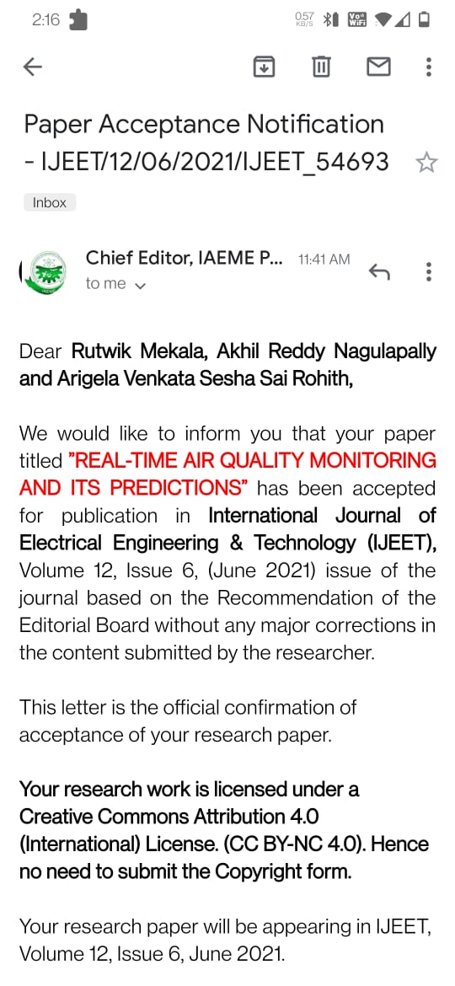
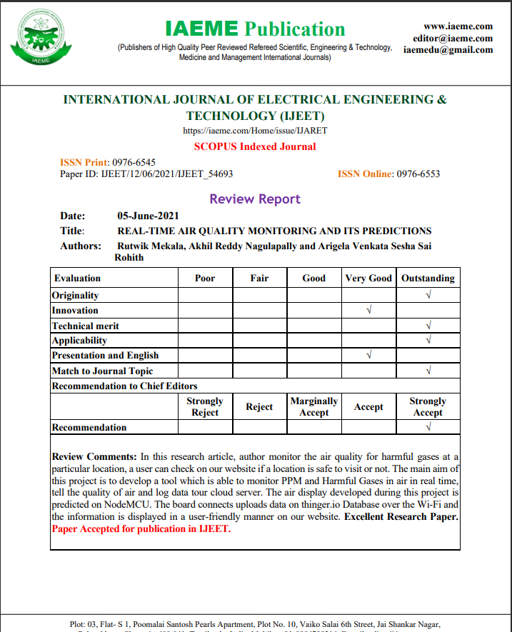
INTERNATION JOURNAL ACCEPTANCE
Scopus Source ID: https://www.scopus.com/sourceid/21100983110
Scope Database Index: https://scopedatabase.com/Sourceid/00000003

